Slide 1

Mobility and Deadline-Aware Task Scheduling Mechanism for Vehicular
Edge Computing
TEAM - 25
REVIEW - 2
Edge Team Members
Harish Veylan P CB.SC.U4CSE23722
Nehan GRM CB.SC.U4CSE23660
Karthik P CB.SC.U4CSE23522
Kanish Khan J CB.SC.U4CSE23626
CI Team Members
ARJUN R CB.SC.U4CSE23004
SAKTHI KARTHIK BC CB.SC.U4CSE23010

Slide 2
Problem Statement
Vehicular Edge Computing (VEC) systems must handle low-latency, mobility-sensitive task scheduling across dynamically available Vehicular Cloud (VC) resources. However, efficiently deciding where and when to execute tasks
Considering ,
task deadlines
node mobility
resource availability

Slide 3
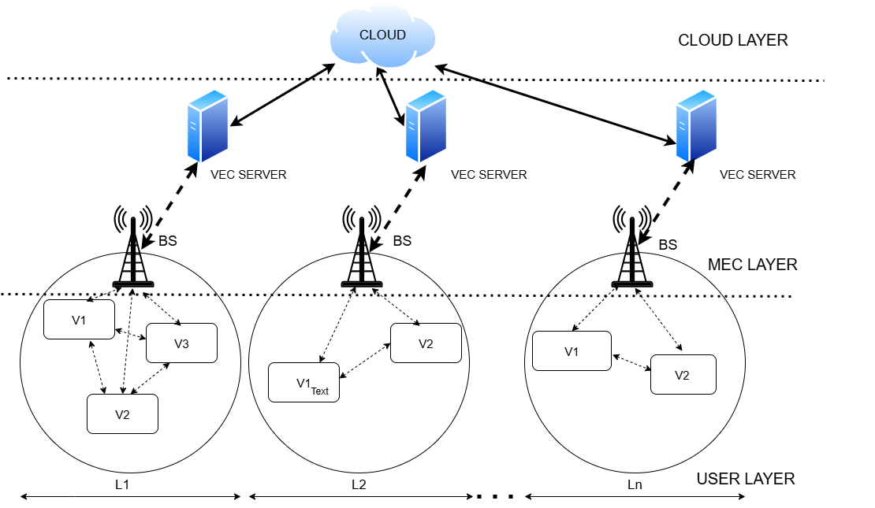
Architecture Diagram

Slide 4
ISSUES RAISED
How vehicle can be an edge considering its low
computation power ?
How will we handle interoperability across various
regions(remote regions) ?
If Vehicles are highly mobile and
unpredictable, how will we
schedule tasks ?

Slide 5
Resolutions
Modern vehicles already host powerful onboard units (e.g., NVIDIA Jetson, Qualcomm Snapdragon Ride, Tesla FSD chips) capable of tens to hundreds of TOPS for ADAS and AI tasks. These resources can be partially shared for VEC, letting vehicles run lightweight tasks, preprocess sensor data, or cache content. In MARINA, such vehicles act as edge nodes, and when pooled into a vehicular cloud, they provide meaningful compute power.
Use standardized APIs/middleware (ETSI MEC, MQTT, DDS) so regional VEC controllers can coordinate. In remote/low-connectivity areas, rely on local processing, store-and-forward, and V2V relaying until reconnection is possible.
MARINA tackles this by using an LSTM-based mobility prediction model to forecast whether a vehicle or RSU will remain available during task execution. This prediction feeds into the scheduler, helping it avoid assigning tasks to nodes that may soon disconnect, ensuring more reliable execution.

Slide 6
Problem Formulation:
Task Representation:
Each task t1∈T is defined as a tuple:
tl={idl,sl,wl,Dl}
idl: Unique task ID
sl: Size of input data
wl​: CPU cycles required
Dl​: Deadline constraint
Computation Delay:
The task computation delay in VC vj is:
dlj=wl/j
where j is the processing capacity adjusted for the number of tasks sharing the VC.

Slide 7
Cost Function:
The monetary cost for executing task tl is:
Cl=dlj×wl×Price(tl)
where Price(tl)depends on the resource provider.
Constraints:
Task deadlines must be satisfied: dlj ≤ Dl
Storage and CPU capacity limits in VCs must not be exceeded.

Slide 8
Algorithms Used:
Pareto Optimization:
Identify tasks that jointly minimize computation time and respect deadlines to reduce cost.
Bin Covering Problem (BCP):
Model the scheduling as a packaging problem where tasks are packed into bins (VCs), aiming to maximize the number of tasks.
Heuristic Algorithm:
Use the First-Fit Decreasing (FFD) heuristic to efficiently assign tasks based on size and capacity constraints.

Slide 9

Code Walkthrough – Vehicular Edge Computing with MARINA Scheduler
Purpose: Efficient task scheduling in vehicular cloud environments.
Key components:
Base Station: Communication hub.
Scheduler (MARINA): Allocates tasks based on vehicle state.
Resource Prediction: Estimates Position, speed, etc.Inputs: Vehicle trace data (sample_vehicle_trace.csv).Outputs: Task execution logs and performance metrics.

Slide 10

Scheduler and Task Allocation
Task.java:
Encapsulates task parameters such as load, deadlines.
Provides methods for updating task status.
MARINAScheduler.java:
Prioritizes tasks based on predicted data.
Dynamically assigns tasks to available vehicles.
Result: Improved resource utilization and task completion rates.

Slide 11

Resource Prediction
ResourcePredictor.java:
Uses past data to forecast vehicle resource availability.
Python scripts:
speed_predictor.py, xy_predictor.py implement regression models.
Helps MARINA adapt to varying speeds and locations

Slide 12

Integration & Testing
TraceLoader.java reads vehicle movement data.
TestMARINA.java runs simulations with real-world scenarios.
Outputs show:
Task success rates.
System latency and efficiency.
Python models enhance scheduling decisions in real-time.

Slide 13





LSTM
This project focuses on predicting vehicle trajectories using a three-module system built with Long Short-Term Memory (LSTM) neural networks. The system's main purpose is to forecast a vehicle's future position, speed, and CPU usage. The modular design makes the code organized and easy to manage, while the LSTMs are used for their ability to handle time-series data. The program also features dynamic data handling, allowing for new vehicle data to be added on the fly.

Slide 14


LSTM Predictors
This code builds a time-series predictor that forecasts future (x, y) values using an LSTM (Long Short-Term Memory) neural network. It first scales the input data between 0 and 1 using MinMaxScaler to improve model training. The model is trained with the Adam optimizer and mean squared error loss over a chosen number of epochs and batch size.
Algorithmically, it uses sliding window sequence generation to turn raw data into supervised learning samples - each input window of time steps predicts the next (x, y) pair. It predicts the next value, appends it to the input window, shifts the window forward, and repeats this process to generate multiple future predictions with previously generated values.
Position Predictor
Position Predictor algortithm usage

Slide 15
Speed Predictor
Data Preparation: The model uses only historical Speed data . This data is scaled (normalized 0 to 1 ) using minMax and prepared using a sliding window of past time steps.
Model Building: The model uses Stacked LSTMs. The first LSTM learns initial patterns, passing its output to the second LSTM. The final Dense layer outputs the single predicted Speed value.
Model Training: Training uses the Adam optimizer to minimize the Mean Squared Error (MSE) loss, allowing the network to learn the time-dependent patterns in the speed sequence.
Prediction: Predictions are made one step at a time. Each new Speed prediction is immediately fed back into the input sequence, enabling the model to generate forecasts for multiple steps into the future.

Slide 16
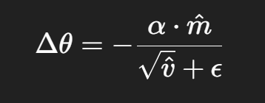
Adam Optimizer
Adam combines Momentum (for direction/smoothness) and RMSprop (for adaptive step size), making it fast and reliable.
It converges faster and more reliably than standard SGD, works well with noisy or sparse data, and automatically adjusts learning rates for each parameter.
Model Training: The optimizer corrects for initial numerical bias, ensuring accurate parameter updates from the very first epoch and promoting training stability.
Steps:
Calculates moving averages of gradients (1st moment) and squared gradients (2nd moment).
Applies bias correction to make estimates accurate early on.
Updates weights using a scaled step size:

Slide 17

Data Handling: It loads existing data from a CSV file and allows users to add new vehicle data via a command-line prompt.
Main.py
Evaluation metrics:
1.Accuracy: Percentage change in predicted data and actual data
2.Mean Absolute Error (MAE): Average of absolute errors
3.Mean Square Error (MSE): Average of squared prediction errors
4. RMS: Square root of MSE
This module, main.py, acts as the central hub, bringing all components together. It orchestrates the training of both LSTM models for all vehicles and generates predictions using the previous instances. It then combines the rounded outputs from both prediction modules into a single, comprehensive dataset.
Output: The module appends all historical and newly predicted data to the original CSV file, creating a continuous record of vehicle movements.

Slide 18
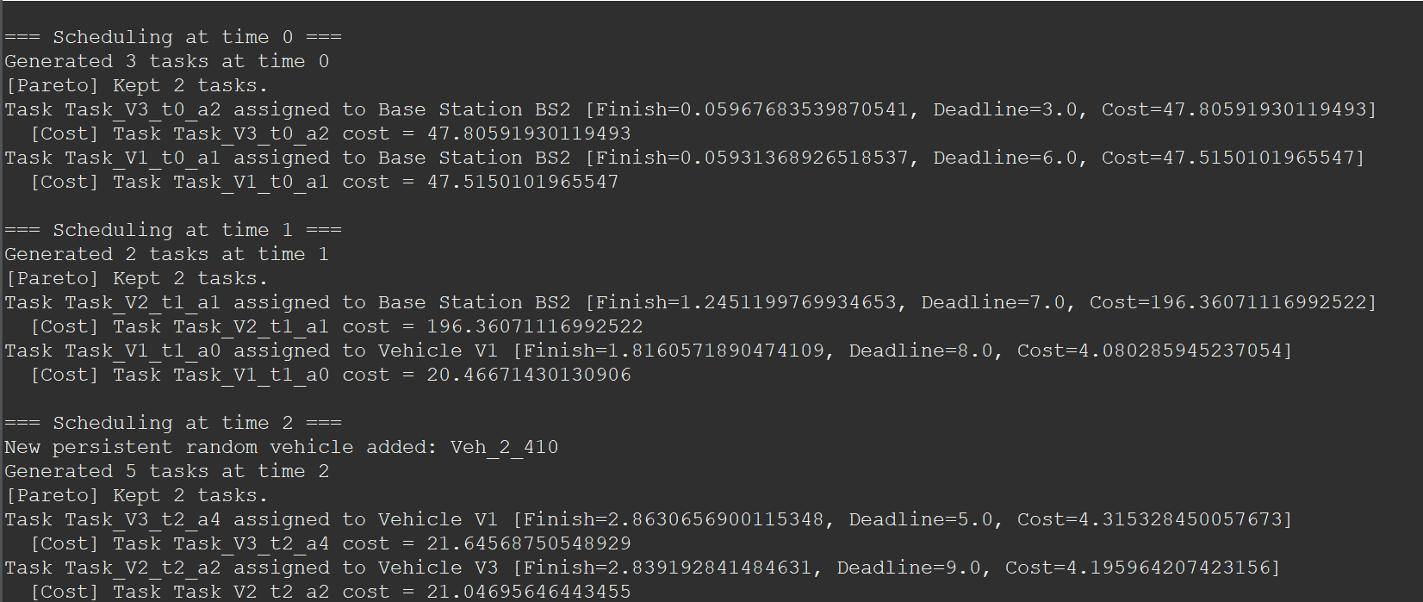
Simulation Result

Slide 19
METRICS AND SIGNIFICANCE OF RESULT
Metrics:
Task Completion Rate – Percentage of tasks executed within deadlines.
Latency – Time between task assignment and completion.
CPU Utilization – CPU usage across vehicles during simulation.
Significance:
Higher task completion rates indicate better scheduling and prediction accuracy.
Lower latency shows the system’s responsiveness under dynamic conditions.
Balanced resource utilization ensures no vehicle is overloaded while others remain idle, improving system reliability.

Slide 20
Thank you

